Slide 1
Chapter 5
Apache Pig and Pig Latin

Slide 2
Big Data Application: LinkedIn
Global online community of professionals
In 2020, had over 500 million users in over 200 countries
Two types of accounts:
Free
Basic features
Premium
Several additional features
“Who viewed your profile“ feature
Uses Pig and Hadoop
LinkedIn stores terabytes of data
With a series of Pig Latin commands:
Generate a list of people who have viewed the profile during a given period

Slide 3
Introduction
Pig:
Platform for structuring, processing, and analyzing Big Data
Developed by Yahoo
Pig commands:
Written in query-based language
Known as Pig Latin
Similar to Structured Query Language (SQL)
Transformed into MapReduce jobs, run in background
Results stored in HDFS

Slide 4
Chapter Objectives:
Understand the advantages and disadvantages of using Pig for Big Data processing
Describe the major components of Pig and its execution modes
Explain various data models and data types in Pig
Perform Big Data analysis by executing Pig Latin commands

Slide 5
Pig vs. MapReduce
MapReduce:
The programming code should be written by the data scientists
Developing jobs is challenging
Challenging to manage when written for multiple stages/iterative tasks
Every task must be written in terms of mapper and reducer
Pig:
Created as higher-level data flow platform
To provide a simpler language for queries and data manipulation
Pig commands written in Pig Latin
Upon execution, they are compiled into MapReduce jobs
Are run on Hadoop
No need to know Java or Python
Data flow language similar to SQL

Slide 6
Pig vs. MapReduce (cont.)
Pig scripts:
Easier and faster to write than standard Java MapReduce jobs
Pig:
Is not intended to replace MapReduce
Works better with structured data files
Should be avoided with unstructured data:
Video, audio, raw text files
Command execution slower than that of MapReduce jobs
Due to additional layer (compilations) required to translate the Pig commands into mappers and reducers

Slide 7
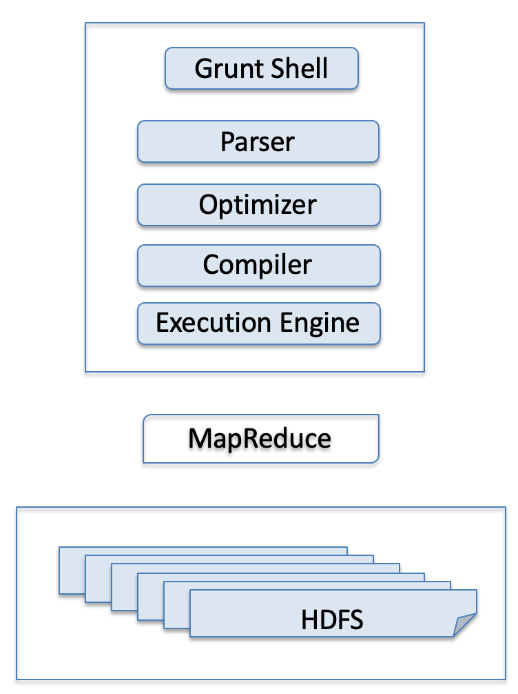
Figure 5-1: Pig Architecture Components

Slide 8
Pig Components and the Execution Modes
Parser:
Checks the syntax of Pig Latin commands
Optimizer:
Improves the efficiency of the upcoming MapReduce jobs:
Converted by the complier
Logical optimizations:
Deciding on optimal number of MapReduce jobs
Balancing the workload on DataNodes during the map and reduce stages
Minimizing the amount of data shuffled during the shuffle stage

Slide 9
Pig Components and the Execution Modes (cont.)
Complier:
Provides an execution layer that produces sequences of MapReduce jobs
Execution layer found in:
Local environment:
Consists of JVM
Known as “local mode”
Recommended when dealing with small datasets
Distributed execution environment:
Called the “MapReduce mode”
Pig resides on user’s machine
The compiled MapReduce jobs are executed on the Hadoop cluster

Slide 10
Pig Components and the Execution Modes (cont.)
Pig Latin commands:
Executed using the interactive grunt> shell
To invoke grunt>:
In local mode:
$ pig –x command is used
In MapReduce mode:
$ ./pig –x mapreduce is used
Running Pig Latin operators:
Interactive mode
Noninteractive shell (script mode)
Run Pig scripts in a noninteractive shell:
In local environment
MapReduce mode
$ pig -x local my_script.pig
$ pig -x MapReduce my_script.pig

Slide 11
Pig Latin Data Types
Four basic types:
Atom
Tuple
Bag
Map

Slide 12
Pig Latin Data Type: Atom
The simplest, indivisible (atomic) value
Stored as:
int
long
double
float
chararray
bytearray
boolean

Slide 13
Table 5‑1: Primitive Data Types in Pig Latin
Data Type | Description | Explanation
int | A 32-bit signed integer | Any integer in the range: -2,147,483,648 to 2,147,483,647
long | A 64-bit signed integer | Any integer in the range: -9,223,372,036,854,775,808 to 9,223,372,036,854,775,807
float | A 32-bit floating-point | A system that uses a fixed number of digits to represent numbers of different orders of magnitude. For example, 1.234 is represented as 1234*10⁻³, and 123,400 is represented as 1234*10² [65].
double | A 64-bit floating-point | Similar to float but for a much larger set of numbers
chararray | A character array similar to a string in Java | Examples: "Tirana", "Hello, World!", "I love Big Data"
bytearray | An array that represents bytes; the default data type | If an atom is of bytearray data type, the function size() for that atom returns the number of bytes in the array.
boolean | Represents true/false values | Yes/No, open/close

Slide 14
Pig Latin Data Type: Tuple
The atomic values combined:
To create a set of values called tuples
Sequence of atoms that can be any of the data types
Examples:
('Paris', 0.25)
(3.14, 'circle', 'teacher', 'Chatty', 1994, 'YES')
('World Cup', 'Euro 2020', 2020)

Slide 15
Pig Latin Data Type: Bag
Collection of tuples and atoms of potentially varying structures
Examples:
{('Tirana'), ('World Cup', 'Euro 2020', 2020)}
{('Yes', 2020), ('Paris', 0.25)}
{('I love Big Data'), ('Hello, World!', ('Paris', 0.25))}

Slide 16
Pig Latin Data Type: Map
Associative array in the form of a key-value pair
The key => chararray data type
The value => any data type
The key and value are separated by a "#"
Examples:
['Albania'#'Tirana']
['capitals'#('Tirana', 'Paris')]
['cities'#{'capitals', ('Chatty', ('World Cup', 'Euro 2020', 2020))}]

Slide 17
Table 5-2: Summary of Pig Latin Operators
Category | Operator | Description
Loading and Storing | LOAD | Load files from the cluster
 | STORE | Store files to the cluster
 | DUMP | Display results on the screen
Filtering and Sorting | FILTER | Filter records, similar to where in SQL
 | FOREACH … GENERATE | Generate a relation, similar to select in SQL
 | ORDER … BY | Sort results in ascending or descending order
 | LIMIT N | Limit the records to only n tuples
Grouping and Joining | JOIN | Join two relations by a similar field in each relation, similar to join in SQL
 | GROUP… BY | Group tuples according to a given field
 | COGROUP | Group tuples that have the same group key
 | UNION | A simple combination of two or more relations
 | TOKENIZE | Create tokens (words) from a text line that is loaded as a chararray data type
 | FLATTEN | Flatten the file by un-nesting tuples and bags
Diagnostic | DESCRIBE | Display the structure and data types of a relation
 | EXPLAIN | Display the logical, physical, and MapReduce plan of a relation
 | ILLUSTRATE | Show how sample data are processed

Slide 18
Tutorial A: Website Visitors
Pig Latin commands are used:
To rank each visitor based on average rank of the web page they have visited
To display a list of visitors who have visited pages with an average ranking >=75
Uses two CSV data files:
VisitorLog:
Contains information about web page visitors
PageRank:
Contains a list of the visited web pages and their overall ranking

Slide 19
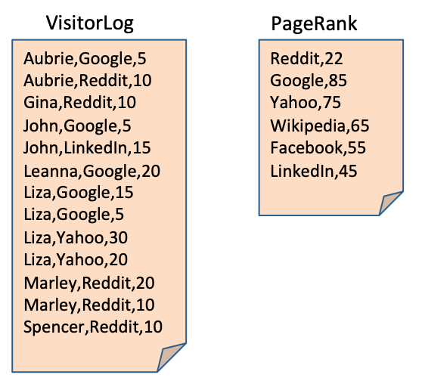
For example:
Aubrie has spent 5 minutes on Google:
With a web page rank of 85
and 10 minutes on Reddit:
With a web page rank of 22
The overall ranking for Aubrie is calculated as:
(85 + 22)/2 = 53.5
Figure 5-2: Hypothetical Data About Visitors and Web Pages

Slide 20
Tutorial A: Creating Directories
Create directories where the files will be placed
Put the input files in HDFS
Invoke grunt shell
$ hadoop fs -mkdir PG
$ hadoop fs -mkdir PG/TutorialA
$ hadoop fs -mkdir PG/TutorialA/input
$ hadoop fs -copyFromLocal VisitorLog PG/TutorialA/input
$ hadoop fs -copyFromLocal PageRank PG/TutorialA/input
$ pig

Slide 21

Tutorial A: Load Files
The file visitors has three fields:
name (chararray), site (chararray), time (int)
Show the results of the file:
grunt> visitors = LOAD 'PG/TutorialA/input/VisitorLog' USING PigStorage(',') AS(name:chararray,site:chararray, time:int);
grunt> DUMP visitors;
Figure 5‑3: Bag of visitors Records

Slide 22
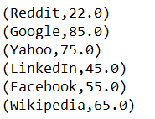
Tutorial A: Load Files (cont.)
The file webpages has two fields:
site (chararray), rating (double)
Show results:
grunt> webpages = LOAD 'PG/TutorialA/input/PageRank' USING PigStorage(‘,’) AS(site:chararray,rating:double);
grunt> DUMP webpages;
Figure 5‑4: Bag of webpages Records

Slide 23
Tutorial A: Storage Functions
PigStorage:
Load the relations using a field-delimited text format
The default delimiter is "tab"
Other delimiters specified in the command line by using PigStorage(' ')
HBaseStorage:
Used when loading data from HBase
BinStorage:
Used when loading data from binary files
BinaryStorage:
Used when files contain bytearray data types

Slide 24
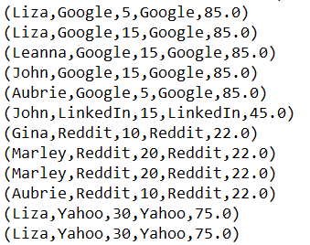
Tutorial A: Join Bags
By respective fields:
Do not have to be named the same
grunt> visitors_webpages = JOIN visitors BY site, webpages BY site;
grunt> DUMP visitors_webpages;
Figure 5-5: The Result of the join Operation

Slide 25
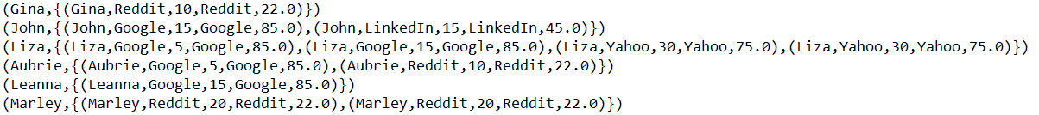
Tutorial A: Group Records
Grouped by specific fields
Visitor Aubrie is shown in two tuples (6 and 10) in the relation visitor_webpage
Aubrie is grouped as one bag (4) in the relation group_by_visitor
grunt> group_by_visitor = GROUP visitors_webpages BY name;
grunt> DUMP group_by_visitor;
Figure 5-6: The Results of the dump group_by Command

Slide 26
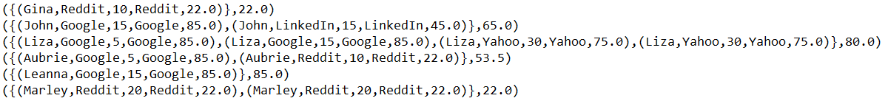
Tutorial A: Calculate Average Rank
grunt> avg_rank = FOREACH group_by_visitor GENERATE visitors_webpages, AVG(visitors_webpages.rating) AS AR;
grunt> DUMP avg_rank;
Figure 5-7: List of Visitors, Web Page Activity, and the Overall Rank

Slide 27
Tutorial A: Filter Records
Filter visitors with average rank > 75.0
grunt> TopRank = FILTER avg_rank BY AR>75.0;
grunt> DUMP TopRank;
Figure 5-8: List of Visitors with an Overall Ranking Above 75

Slide 28
Tutorial A: Store Results
Store the final results:
Exit from grunt>
List content of stored results in HDFS
grunt> STORE TopRank INTO 'PG/TutorialA/output' USING PigStorage(',');
grunt> quit
$ hadoop fs -ls PG/TutorialA/output
$ hadoop fs –cat PG/TutorialA/output/p*
Figure 5-9: Output Directory Files
Figure 5-10: Results of store and cat Commands

Slide 29
Box 5-1: Summary of Tutorial A
$ hadoop fs -mkdir PG
$ hadoop fs -mkdir PG/TutorialA
$ hadoop fs -mkdir PG/TutorialA/input
$ hadoop fs -copyFromLocal VisitorLog PG/TutorialA/input
$ hadoop fs -copyFromLocal PageRank PG/TutorialA/input
$ pig
grunt> visitors = LOAD 'PG/TutorialA/input/VisitorLog' USING PigStorage (',') AS(name:chararray,site:chararray, time:int);
grunt> DUMP visitors;
grunt> webpages = LOAD 'PG/TutorialA/input/PageRank' USING PigStorage (',') AS(site:chararray, rating:double);
grunt> DUMP webpages;
grunt> visitors_webpages = JOIN visitors BY site, webpages BY site;
grunt> DUMP visitors_webpages;
grunt> group_by_visitor = GROUP visitors_webpages BY name;
grunt> DUMP group_by_visitor;
grunt> avg_rank = FOREACH group_by_visitor GENERATE visitors_webpages, AVG(visitors_webpages.rating) AS AR;
grunt> DUMP avg_rank;
grunt> TopRank = FILTER avg_rank BY AR>75.0;
grunt> DUMP TopRank;
grunt> STORE TopRank INTO 'PG/TutorialA/output' USING PigStorage(',');
grunt> quit
$ hadoop fs -ls PG/TutorialA/output
$ hadoop fs -cat PG/TutorialA/output/p*

Slide 30
Tutorial B: Fast-Food Employees
Two tab-separated input files:
EmployeePT:
Contains information about the IDs of the part-time employees
Names, ages, average weekly hours they have worked
EmployeeWeek:
Contains a list of IDs
Names, number of weeks that the employees have been with the company
Null values means no values

Slide 31
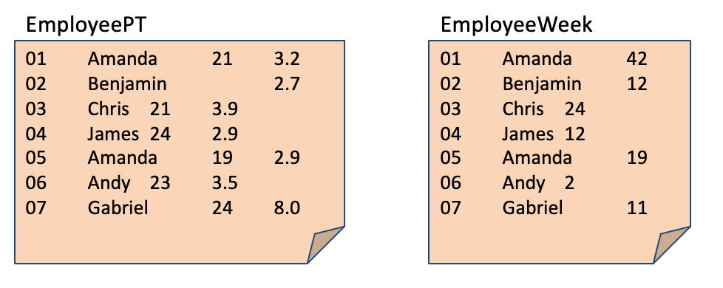
Figure 5-11: Hypothetical Data About Part-Time Employees

Slide 32
Tutorial B: Create Directories, Move Files in HDFS, Invoke grunt>
$ hadoop fs -mkdir PG/TutorialB
$ hadoop fs -mkdir PG/TutorialB/input
$ hadoop fs -copyFromLocal EmployeePT PG/TutorialB/input
$ hadoop fs -copyFromLocal EmployeeWeek PG/TutorialB/input
$ pig

Slide 33
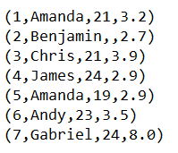
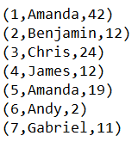
Tutorial B: Load Files
grunt> emp = LOAD 'PG/TutorialB/input/EmployeePT' AS(id:int, name:chararray, age:int, hours:float);
grunt> DUMP emp;
grunt> empweek = LOAD 'PG/TutorialB/input/EmployeeWeek' AS(id:int, name:chararray, week:int);
grunt> DUMP empweek;
Figure 5-12: emp Relation
Figure 5-13: empweek Relation

Slide 34
Tutorial B: Diagnostic Operators
Describe:
Prints a relation's schema (field names and data types)
Explain prints:
Logical plan:
Pipeline of operators to be executed to build the relation
Physical plan:
How the data are processed
MapReduce plan:
How the mappers and reducers are run
Illustrate:
Demonstrates how sample input data are processed
grunt> DESCRIBE emp;
Figure 5-14: Structure of emp Relation

Slide 35
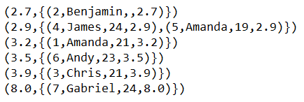
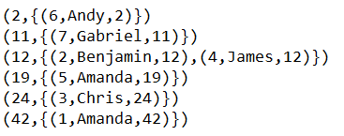
Tutorial B: Group Records
Groups the records of emp according to their average hours worked per week
grunt> hrs = GROUP emp BY hours;
grunt> DUMP hrs;
Figure 5-15: group emp by hours
Groups the empweek by the number of weeks that they have been working for the company
grunt> wk = GROUP empweek BY week;
grunt> DUMP wk;
Figure 5-16: group empweek by week

Slide 36
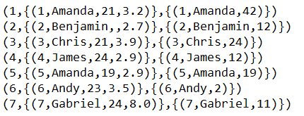
Tutorial B: Cogroup Records
Brings groups together with tuples that have the same group key
grunt> groupID = COGROUP emp BY id, empweek BY id;
grunt> DUMP groupID;
Figure 5-17: Results of the cogroup Command

Slide 37
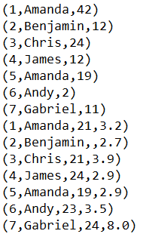
Tutorial B: Union Records
Combines multiple relations
grunt> bigFile = UNION emp, empweek;
grunt> DUMP bigFile;
Figure 5-18: Results of the union Command

Slide 38
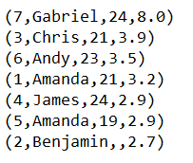
Tutorial B: Order Results
Used to order tuples by a certain category or field
The asc or desc qualifier is used to order the tuples in ascending or descending order
By default, the tuples are ordered in ascending order, and asc might be omitted
grunt> mosthours = ORDER emp BY hours DESC;
grunt> DUMP mosthours;
Figure 5-19: Results of the order Command

Slide 39

Tutorial B: Limit Records and Store
Display a certain number of records in a relation
grunt> topEmp = LIMIT mosthours 3;
grunt> DUMP topEmp;
Figure 5‑20: Results of the limit Command
grunt> STORE topEmp INTO 'PG/TutorialB/output';

Slide 40

Tutorial B: List Results in HDFS
$ hadoop fs -ls PG/TutorialB/output
$ hadoop fs –cat PG/TutorialB/output/p*
Figure 5-21: Top Employees in the Output Directory File
Figure 5-22: Top Employees File

Slide 41
Box 5-2: Summary of Tutorial B
$ hadoop fs -mkdir PG/TutorialB
$ hadoop fs -mkdir PG/TutorialB/input
$ hadoop fs -copyFromLocal EmployeePT PG/TutorialB/input
$ hadoop fs -copyFromLocal EmployeeWeek PG/TutorialB/input
$ pig
grunt> emp = LOAD 'PG/TutorialB/input/EmployeePT' AS(id:int, name:chararray, age:int, hours:float);
grunt> DUMP emp;
grunt> empweek = LOAD 'PG/TutorialB/input/EmployeeWeek' AS(id:int, name:chararray, week:int);
grunt> DUMP empweek;
grunt> DESCRIBE emp;
grunt> hrs = GROUP emp BY hours;
grunt> DUMP hrs;
grunt> wk = GROUP empweek BY week;
grunt> DUMP wk;
grunt> groupID = COGROUP emp BY id, empweek BY id;
grunt> DUMP groupID;
grunt> bigFile = UNION emp, empweek;
grunt> DUMP bigFile;
grunt> mosthours = ORDER emp BY hours DESC;
grunt> DUMP mosthours;
grunt> topEmp = LIMIT mosthours 3;
grunt> DUMP topEmp;
grunt> STORE topEmp INTO 'PG/TutorialB/output';
grunt> quit
$ hadoop fs -ls PG/TutorialB/output
$ hadoop fs -cat PG/TutorialB/output/p*

Slide 42
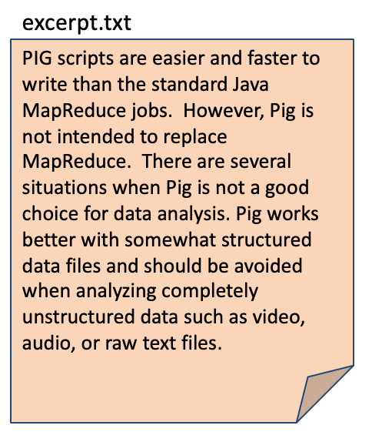
Tutorial C: The WordCount Problem
Figure 5-23: Sample Input File

Slide 43
Tutorial C: Create Directories and Upload Files in HDFS
$ hadoop fs -mkdir PG/TutorialC
$ hadoop fs -mkdir PG/TutorialC/input
$ hadoop fs -copyFromLocal excerpt.txt PG/TutorialC/input
$ pig

Slide 44
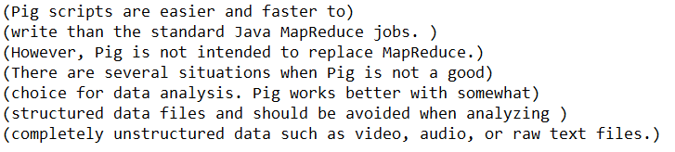
Tutorial C: Load File
grunt> lines = LOAD 'PG/TutorialC/input/excerpt.txt' AS(line:chararray);
grunt > DUMP lines;
Figure 5 24: Loaded excerpt.txt File

Slide 45
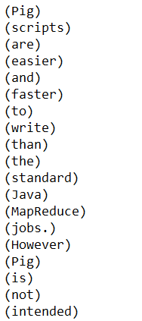
Tutorial C: Create Bags of Words
Tokenize function creates a "bag" of words
Flatten function converts each word into a tuple
grunt> WORDS = FOREACH lines GENERATE FLATTEN(TOKENIZE(line)) AS word;
grunt > DUMP WORDS;
Figure 5-25: Tokenized and Flattened Words

Slide 46
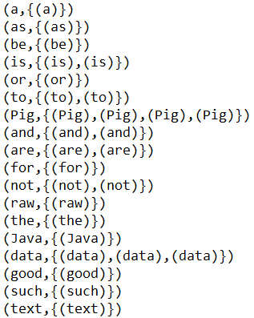
Tutorial C: Group Words
grunt> GroupedWords = GROUP WORDS BY word;
grunt > DUMP GroupedWords;
Figure 5-26: Grouped Words

Slide 47
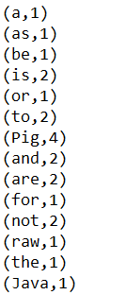

Tutorial C: Count Frequency and Sort the Results
grunt> WordCount = FOREACH GroupedWords GENERATE group, COUNT(WORDS) AS frequency;
grunt> dump WordCount;
Figure 5-27: Counted Words
grunt> OrderedList = ORDER WordCount BY frequency DESC;
grunt> DUMP OrderedList;
Figure 5 28: Ordered Words by Frequency

Slide 48
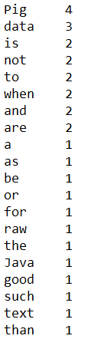
Tutorial C: Store and Display in HDFS
grunt> STORE OrderedList INTO 'PG/TutorialC/output’;
grunt> quit;
$ hadoop fs -ls PG/TutorialC/output
$ hadoop fs -cat PG/TutorialC/output/p*
Figure 5-29: Stored Results

Slide 49
Box 5-3: Summary of Tutorial C
$ hadoop fs -mkdir PG/TutorialC
$ hadoop fs -mkdir PG/TutorialC/input
$ hadoop fs -copyFromLocal excerpt.txt PG/TutorialC/input
$ pig
grunt> lines = LOAD 'PG/TutorialC/input/excerpt.txt' AS(line:chararray);
grunt> DUMP lines;
grunt> WORDS = FOREACH lines GENERATE FLATTEN(TOKENIZE(line)) AS word;
grunt> DUMP WORDS;
grunt> GroupedWords = GROUP WORDS BY word;
grunt> DUMP GroupedWords;
grunt> WordCount = FOREACH GroupedWords GENERATE group, COUNT(WORDS) AS frequency;
grunt> DUMP WordCount;
grunt> OrderedList = ORDER WordCount BY frequency DESC;
grunt> DUMP OrderedList;
grunt> STORE OrderedList INTO 'PG/TutorialC/output';
grunt> quit
$ hadoop fs -ls PG/TutorialC/output
$ hadoop fs -cat PG/TutorialC/output/p*

Slide 50
Additional Considerations When Using Pig and Pig Latin
Pig is not intended to replace MapReduce:
It offers more efficiency when coding
Execution engine's runtime is significantly higher and can lead to significant delay in data processing
First step of using Pig for data analysis is to use PigStorage when loading files
You may use HBaseStorage when loading data from HBase
BinStorage is used when loading data from Binary files
BinaryStorage is used when files contain bytearray data types

Slide 51
Additional Considerations (cont.)
Pig Latin is a data flow language; each processing step results in a new relation; when running emp = LOAD 'data’;, emp is the name of the relation resulting from loading the data
Pig Latin also has field names. When using: emp = LOAD 'EmployeePT' AS (ID, name, page, time); you rename the fields as written
Field and relation names must start with an alphabetic character and are case-sensitive
Pig Latin keywords are not case-sensitive, thus DUMP, Dump, and dump are the same

Slide 52
Additional Considerations (cont.)
You can reuse relation names, but it is not recommended
Example: the following code is allowed but leads to confusion, such as being unclear regarding which emp is involved
grunt> emp = LOAD 'EmployeePT' AS (ID, name, page, time);
grunt> emp = FILTER emp BY time > 5;
grunt> emp = FOREACH emp GENERATE UPPER(name);

Slide 53
Summary and Takeaways
Pig is another platform for analyzing Big Data
Pig commands are written in a query-based language known as Pig Latin
Pig scripts are easier and faster to write than standard MapReduce jobs
The execution of Pig commands is slower due to the additional layers required to translate the Pig commands into MapReduce jobs
These layers include:
Parser
Optimizer
Compiler
Execution engine
Here, Pig Latin commands were executed using the grunt> shell on top of the Hadoop cluster

Slide 54
Summary and Takeaways (cont.)
There are four basic types of data values in Pig Latin:
Atom
Tuple
Bag
Map
The atom values in Pig are stored as: integer, long integer, float, double, chararray, bytearray, or Boolean
Pig Latin is a data flow language, and each command results in a new relation
The Pig commands are first written in Pig Latin
Upon execution, they are compiled into MapReduce jobs

Slide 55
Summary and Takeaways (cont.)
Pig:
Works better with structured data files
Should be avoided with unstructured data files
Uses primitive and complex data types
Pig commands can be executed in:
Local mode
MapReduce mode
Pig operators are used to load, transform, display, and store records and allow for complex data processing operations

